Slide 1
School Finance 101
How Connecticut Funds Education
Hartford Edition

Slide 2

Contact Us
For questions or comments about the information presented today, please contact us:
Erika Haynes, Director of Community Engagement
Email: erika.haynes@schoolstatefinance.org
Jen Nakos, Community Engagement Associate
Email: jen.nakos@schoolstatefinance.org
Cristian Corza, Program Translator
Email: cristian.corza@schoolstatefinance.org
To learn more about the School and State Finance, visit us at:
www.schoolstatefinance.org
Or connect with on social media

Slide 3
About the School and State Finance Project
We are a nonpartisan, nonprofit policy organization that works collaboratively with policymakers, communities, and other key stakeholders to develop data-driven solutions that ensure all public school students receive equitable education funding that supports their learning needs.
Mission
Vision
To eliminate racial and economic disparities in Connecticut
education funding.
All Connecticut students have equitable funding, access, and opportunities — no matter their race, socio-economic status, learning needs, or zip code.

Slide 4
Table of Contents
About the School + State Finance Project | 3
Overview | 5
Where You Live Matters | 8
Hartford Education Spending | 12
State Funding via the ECS Formula | 14
What Does this Mean for Hartford? | 29
Special Education | 32
The Role of Wealth and Property Taxes | 39
Racial Disparities in Education Funding | 46
SHEFF Movement | 50
Where Can I Find Hartford’s Education Budget? | 55
ESSER Funding | 58
What You Can Do | 61
Appendix | 65

Slide 5
Overview

Slide 6
Right to a free public education
Education is not a fundamental right under the United States Constitution.
However, all 50 states guarantee the right to a free public education in their constitutions.
Public schools fall under the authority of state government and are primarily funded through state and local tax dollars.

Slide 7
What are the funding sources for K-12 education in Connecticut?
Percent
3.9%
37.3%
58.8%
$12.1B
Source: U.S. Census Bureau. (2022). Table 1: Summary of Public Elementary-Secondary School System Finances by State: Fiscal Year 2020. 2020 Annual Survey of School System Finances. Washington, DC: Author. Available from https://www2.census.gov/programs-surveys/school-finances/tables/2020/secondary-education-finance/ elsec20_sumtables.xls.

Slide 8
Where you live matters

Slide 9
Connecticut Communities
There are 169 cities/towns in Connecticut, each with its own local government.
Since 1909, students in Connecticut have been assigned to the public school district in which they live.
School districts reflect town boundaries, although regional school districts and choice school programs frequently cross town boundaries.

Slide 10
Zoning Practices
Each community in Connecticut has their own zoning committee to decide how land within the town should be used. This impacts who can afford to move to and live in the community.
The zoning committee works together to decide a variety of rules and practices. Some examples include:
A minimum lot size (needing a certain amount of land to build a house on it)
Types of housing (Two-family homes or apartment buildings vs. traditional single family homes)
Floor size minimums (Can you build a smaller house? Or is there a certain minimum square footage for all homes?)
Parking mandates (How many street parking spaces do you need to include when building a home?)
When these zoning regulations result in exclusion of certain community members, they’re referred to as “exclusionary zoning practices”

Slide 11
Segregated Communities
Housing segregation and zoning policies play a large role in the concentration of BIPOC students in a handful of districts.
Approximately 60% of Black students in the state attend a district where the white student population is less than 25% of the district’s total enrollment.
This means that even though the statewide population of BIPOC students versus white students is nearly evenly split, a majority of BIPOC students are actually concentrated in just a handful of districts.

Slide 12
Hartford
Education Spending

Slide 13
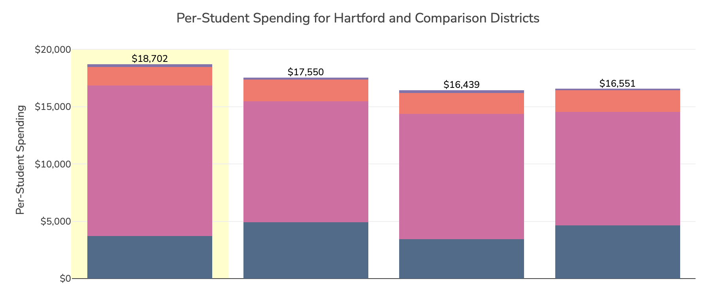
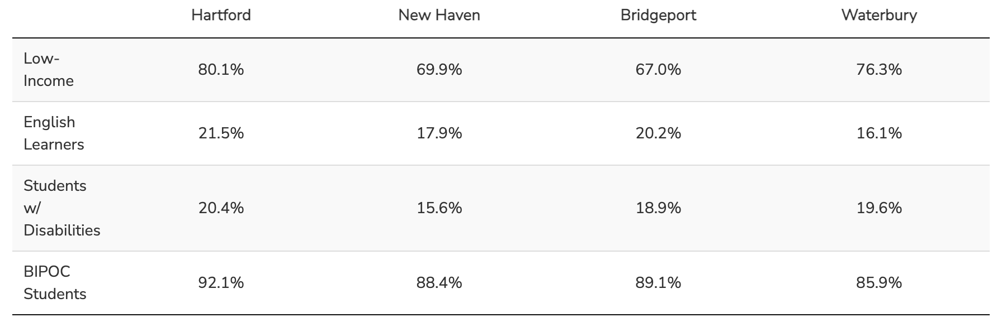

Hartford spends nearly $500 less per student than the state average ($19,134)
Local
State
Federal
Tuition & Other
Student Demographics

Slide 14
State Funding
via
The Education Cost Sharing Formula (ECS)

Slide 15
The ECS formula is used to distribute state education aid to municipalities for their local or regional public school districts

Slide 16
Why CT Has an ECS Formula
The state began providing aid to cities/towns as a result of a 1977 CT Supreme Court decision, Horton v. Meskill.
In Horton (1977), the Court ruled an education funding system that allows “property wealthy” towns to spend more on education with less effort is a system that impedes children’s constitutional rights to an equal education.
As a result, CT established a formula to give money to public school districts that took property wealth into consideration.
In 1988, CT established the Education Cost Sharing (ECS) formula to serve this purpose. It has been revised numerous times since.
In theory, the ECS grant is supposed to make up the difference between what a community can afford to pay and what it costs to run a public school system.
Sources: Horton v. Meskill, 172 Conn. 615 (Conn. Sup. Ct. 1977). Connecticut General Assembly, Office of Legislative Research. (2013). Task Force to Study State Education Funding Final Report. Retrieved from http://www.cga.ct.gov/2013/rpt/2013-R-0064.html.

Slide 17
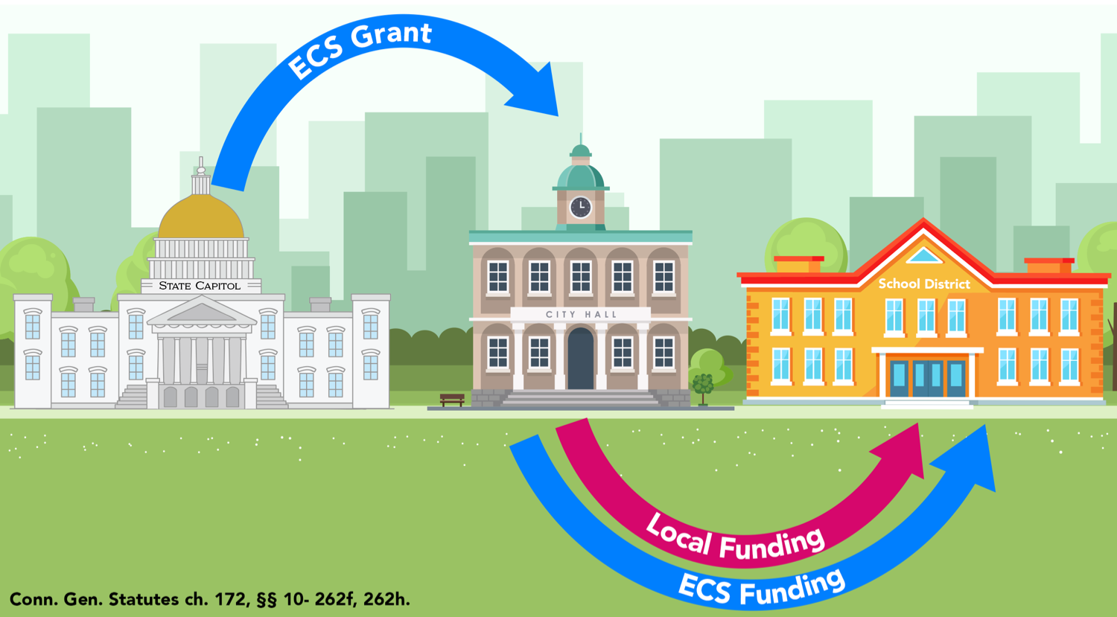
How ECS Funding Flows

Slide 18
Foundation Amount
The ECS formula begins with a foundation amount, which is supposed to represent the amount of money it costs to educate a child with no additional learning needs.
In Connecticut, the foundation amount is established by the legislature
Currently, the foundation amount is $11,525
Source: Conn. Gen. Statutes ch. 172, § 10-262f.

Slide 19


ECS Formula’s Student-Need Weights
Low-Income Student Weight | 30%
Concentrated Poverty Weight Applied to Every Student Above 60% Concentrated Poverty | 15%
English Learner Weight | 25%

Slide 20
Student Need | Funding Per Student
General Education (Non-need) Student | $11,525
Low-income Student (+ $3,458) | $14,983
Concentrated Low-income Student (+ $5,186) | $16,711
Low-income and English Learner (+6,339) | $17,864
English Learner (+$2,881) | $14,406
Concentrated Low-income English Learner (+8,067) | $19,592
Source: Conn. Gen. Statutes ch. 172, § 10-262f.
All numbers are rounded

Slide 21
Base Aid Ratio
A town’s ability to fund its public schools is determined by two factors in the ECS formula. These factors make up the Base Aid Ratio.
Property Wealth Factor | 70%
Income Wealth Factor | 30%

Slide 22
Additional Funding for Towns in Need
Formula adds additional funding for communities that have one of the highest Public Investment Communities (PIC) index scores.
The PIC index is calculated annually by the OPM and measures the relative wealth and need of CT’s towns.
If a town has one of the top 19 highest PIC Index scores, under the ECS formula, the town will receive a bonus of three to six percentage points to its Base Aid Ratio.
Town’s PIC Index Rank | Additional % Points Added to Base Aid Ratio
1-5 | 6 percentage points
6-10 | 5 percentage points
11-15 | 4 percentage points
16-19 | 3 percentage points
Source: Conn. Gen. Statutes ch. 172, § 10-262f.

Slide 23
Factors Impacting a Town’s ECS Grant
Town’s prior year ECS grant amount
# of students residing in town
# of economically disadvantaged students
% of students who are economically disadvantaged
# of students learning English
# of students sent to regional school districts, and how many grades the regional district has
Town’s property wealth (ENGLPC)
Income of town residents (Median Household Income)
PIC Index score
Alliance District status

Slide 24
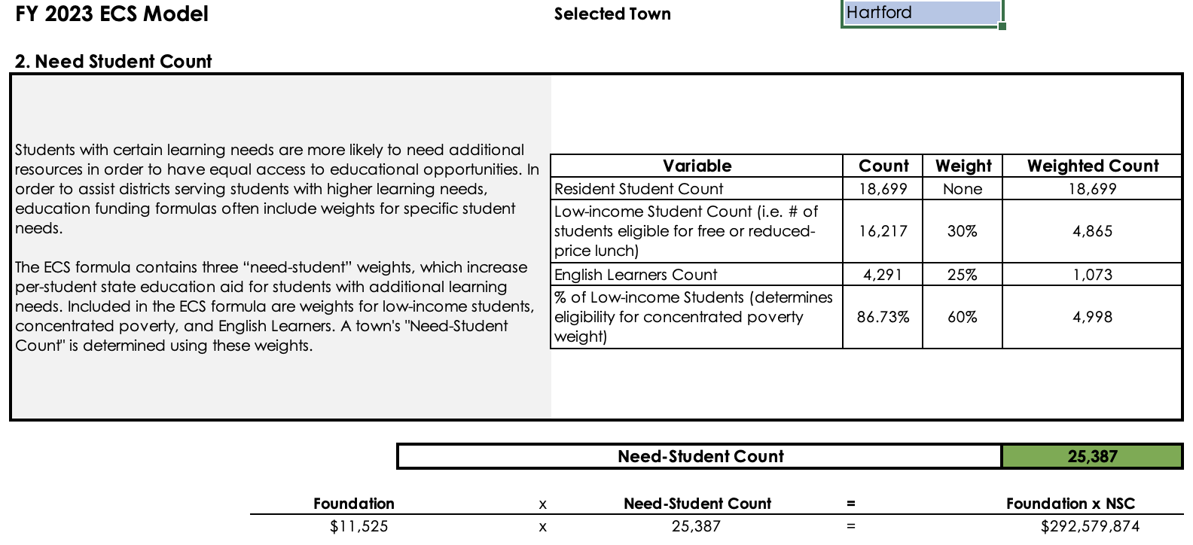
Hartford’s ECS Components: Total Cost

Slide 25
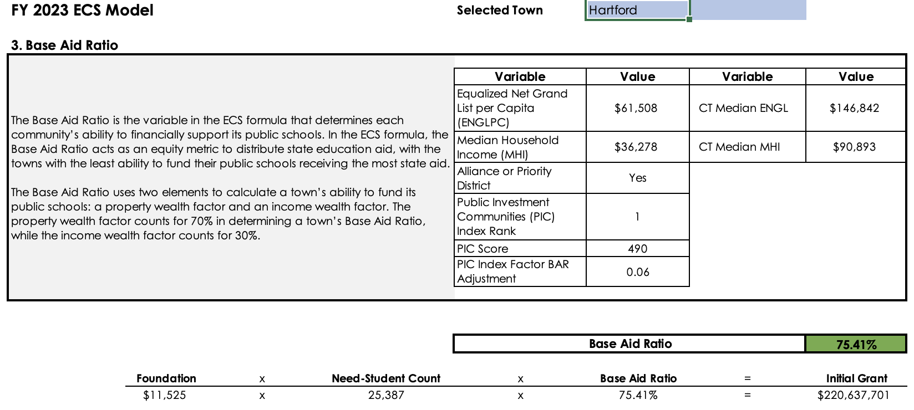
Hartford’s Calculated Base Aid Ratio

Slide 26
Phase-In Schedule
Formula began implementation in FY 2019
Towns receiving increases will be phased in over 10 years (towns receive full funding in 2028)
Towns receiving decreases will be phased out over 12 years (phase-out paused for FY 2022-23)
Alliance Districts that would otherwise receive a decrease in their grant amount are held harmless so they won’t experience cuts to their ECS funding.
Phase-in Schedule
 | FY 2023 | FY 2024 – FY 2027 | FY 2028-2029 | FY 2030
Towns Receiving Increase in ECS Funding Over Prior Year ECS Grant | ECS funding increased gradually |  | Towns receive 100% of their ECS grant
Towns Receiving Decrease in ECS Funding Compared to Prior Year ECS Grant | Held harmless | ECS funding decreased gradually |  | Towns receive 100% of their ECS grant
Source: Conn. Gen. Statutes ch. 172, § 10-262h.

Slide 27
Students who were kindergarteners at the start of the phase-in will not see full funding until they’re in high school

Slide 28
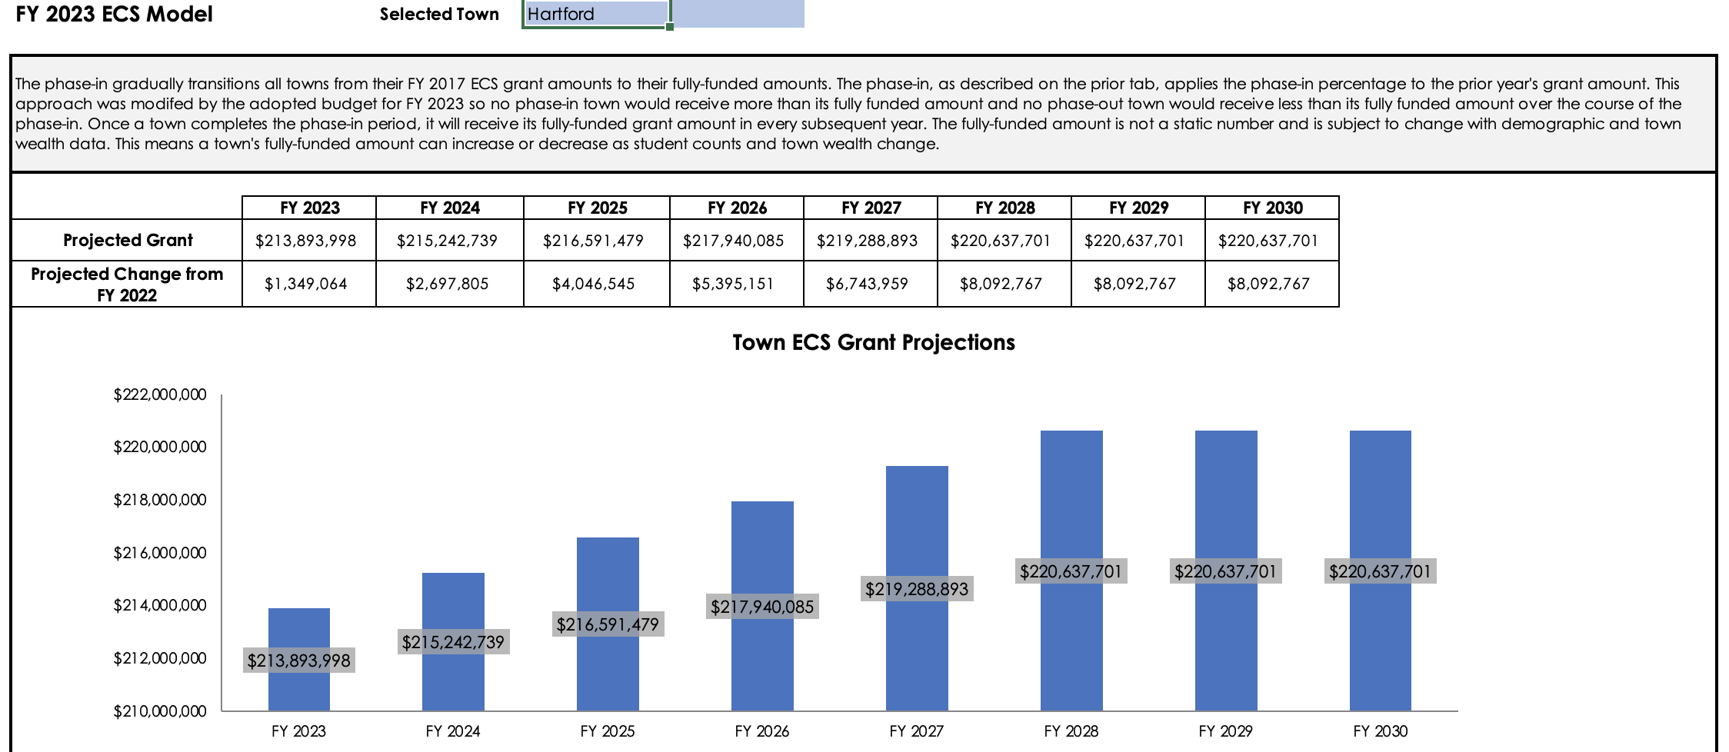
ECS Phase-In for Hartford

Slide 29
What Does this Mean for Hartford?

Slide 30
How do cities and towns raise money to pay for public schools?
Cities and towns raise money to pay for services (including public schools) through property taxes.
Cities and towns are able to collect tax on property that is owned by the people who live there.
Cities and towns can collect taxes on “real” property (e.g. office building, apartment buildings, houses) and “personal” property (e.g. cars and boats).
Property that belongs to some nonprofit organizations, like universities, hospitals, and churches, may be exempt from property tax.
Source: State of Connecticut, Office of Policy and Management. (n.d.). Statutes Governing Property Assessment and Taxation. Retrieved from https://portal.ct.gov/OPM/IGPP/Services/Statutes-Governing-Property-Assessment-and-Taxation.

Slide 31
How much do cities and towns need to contribute toward funding their public schools?
Cities and towns must make up the difference between what their local public school system receives from state and federal sources and the local public school district’s budget.
School District Budget – Federal Revenue – State Revenue
=
Municipal (Local) Contribution

Slide 32
Special Education

Slide 33
Over the last 10 years, the total number of students in Connecticut public schools has declined by 7.4%
Source: Connecticut State Department of Education. (n.d.). EdSight: Public School Enrollment. Available from http://edsight.ct.gov/SASPortal/main.do.

Slide 34
Over the last 5 years, the total number of students with disabilities in Connecticut public schools has increased by 7.3%
Source: Connecticut State Department of Education. (n.d.). EdSight: Public School Enrollment. Available from http://edsight.ct.gov/SASPortal/main.do.

Slide 35
At the state level, special education spending has been predictable over the past 5 years
Source: Connecticut State Department of Education. (n.d). EdSight: Fiscal Resources; Special Education Expenditures. Available from https://edsight.ct.gov/SASPortal/main.do.

Slide 36
Local Special Education Spending
While special education spending has been predictable at the state level, local districts often experience changes in spending due to fluctuations in enrollment and needs.
Source: Connecticut State Department of Education. (n.d). EdSight: Fiscal Resources; Special Education Expenditures. Available from https://edsight.ct.gov/SASPortal/main.do.

Slide 37
How does Connecticut fund special education?
Connecticut is one of the few states in the country that does not have a separate special education funding system.
Connecticut’s local public school districts primarily receive funding for students with disabilities from the ECS grant.
Additionally, districts are partially reimbursed for extraordinary special education costs through the state’s Excess Cost grant.
Excess Cost grant reimburses districts when expenditures for educating a student in special education are 4.5 times greater than the district’s spending per pupil.
For FY 2023, the Excess Cost grant is not fully funded. The actual amount appropriated by the legislature for the Excess Cost grant is approximately 80% of amount needed to fully fund the grant. As a result, districts do not get back all of the money they are eligible to receive.

Slide 38
Changes to Excess Cost Grant
The General Assembly modified the formula for the Excess Cost grant as part of budget adjustments made during the 2022 legislative session.
Under the new formula, if the legislature does not fully fund the Excess Cost grant, districts will be reimbursed using a 3-tiered system that is based on the wealth of their town.
Each town will be ranked in descending order from one to 169, and each tier will be reimbursed at a different rate.
Districts with the lowest wealth (towns ranked 115 to 169) would be reimbursed for 76.25% of their total Excess Costs;
Districts in the middle tier (towns ranked 59 to 114) would be reimbursed for 73.25% of their total Excess Costs and;
Districts in the wealthiest tier (towns ranked 1 to 58) would be reimbursed for 70% of their total Excess Costs.
Source: State of Connecticut, Office of Policy and Management, Budget Division. (2022). Excess Cost Midterm Adjustment Implementation Issue. Hartford, CT: Author.

Slide 39
The Role of Wealth and Property Taxes

Slide 40

One of the most fundamentally flawed parts of education funding is its reliance on local property taxes.
It enables an inequitable system where affluent, predominantly white communities are able to fund their schools at higher levels.

Slide 41
Property Taxes
Cities and towns raise money to pay for town services (including public schools) through property taxes.
Cities and towns are able to collect tax on property that is owned by the people who live there.
Cities and towns can collect taxes on “real” property (e.g. office building, apartment buildings, houses) and “personal” property (e.g. cars and boats).
Property that belongs to some nonprofit organizations, like universities, hospitals, and churches, may be exempt from property tax.
Source: State of Connecticut, Office of Policy and Management. (n.d.). Statutes Governing Property Assessment and Taxation. Retrieved from https://portal.ct.gov/OPM/IGPP-MAIN/Services/Statutes-Governing-Property-Assessment-and-Taxation

Slide 42
Grand List & Mill Rates
The value of a town’s taxable property is called a grand list.
The rate at which personal property is taxed by a town is known as a mill rate.
Communities with a higher grand list need to tax less in order to generate funding for their schools. Communities with a lower grand list must tax more in order to generate funding for their schools.

Slide 43
The Value of Grand Lists Varies Widely
Municipality | Equalized Net Grand List GLYR 2019
GREENWICH | $48,909,139,349
STAMFORD | $33,016,329,131
NORWALK | $21,228,733,652
FAIRFIELD | $16,488,524,937
WESTPORT | $16,334,520,630
… | …
HARTFORD | $7,482,907,669
… | …
EASTFORD | $261,088,420
CANAAN | $256,346,918
HAMPTON | $243,848,959
SCOTLAND | $169,044,963
UNION | $142,597,226
$48.8B
Source: State of Connecticut, Office of Policy and Management. (2022). Municipal Fiscal Indicators, Fiscal Years Ended 2016-2020. Hartford, CT: Author. Retrieved from https://portal.ct.gov/-/media/OPM/IGP/munfinsr/Municipal-Fiscal-Indicators/Municipal-Fiscal-Indicators-2016-20-Final-AsOf7-28-22.pdf.

Slide 44
Equalized Net Grand List per Capita (ENGLPC) represents the value of taxable property
in a town per resident
Lower $ Per Pupil
Higher $ Per Pupil
Sources: State of Connecticut, Office of Policy and Management. (2022). Municipal Fiscal Indicators, Fiscal Years Ended 2016-2020. Hartford, CT: Author. Retrieved from https://portal.ct.gov/-/media/OPM/IGP/munfinsr/Municipal-Fiscal-Indicators/Municipal-Fiscal-Indicators-2016-20-Final-AsOf7-28-22.pdf. Connecticut State Department of Education. (n.d.). Per Pupil Expenditures by Function (District), 2020-2021. Available from https://edsight.ct.gov/.

Slide 45
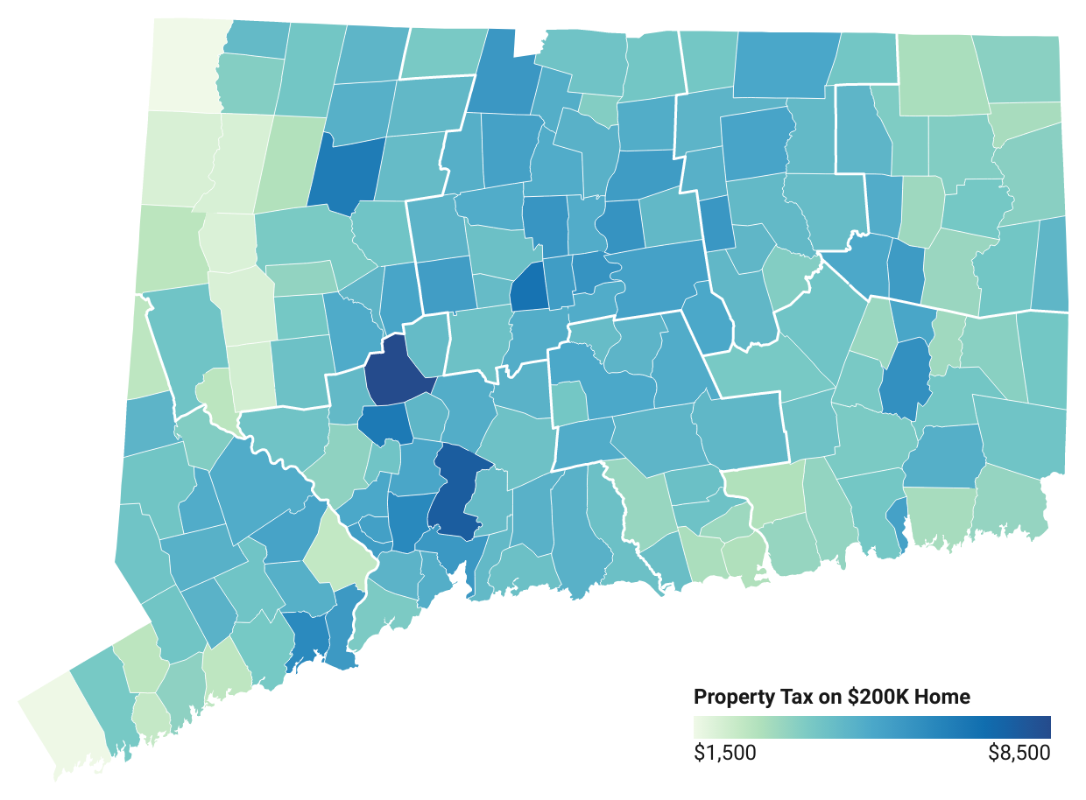
Property Taxes on a $200,000 House
West Hartford: $5,695
New Britain: $6,930
Hartford: $4,827
Waterbury: $8,429
Norwich: $5,856
New Haven: $5,565
Stonington: $3,312
Bridgeport: $6,083
New London: $5,223
Greenwich: $1,579

Slide 46
Racial Disparities in education funding

Slide 47
$713 million
Funding gap between districts serving student populations that are less than 25% BIPOC and all other districts.

Slide 48
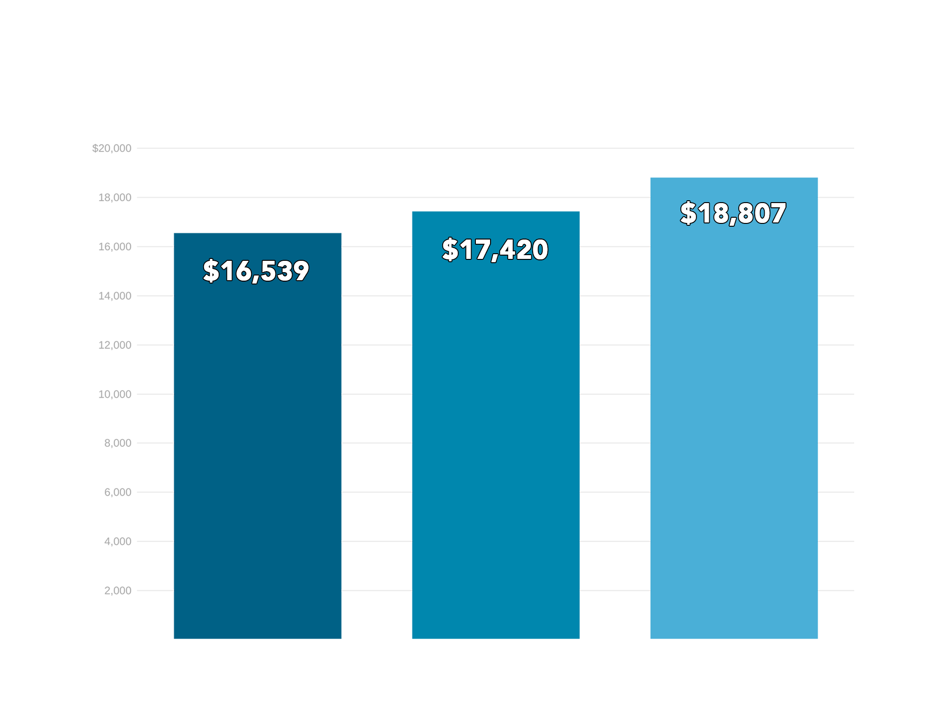
Districts whose student populations are > 75% BIPOC students spend roughly $2,300 less per student than districts with populations of < 25% BIPOC students
> 75%
BIPOC
25%-75% BIPOC
< 25%
BIPOC

Slide 49
What $2,300 Less Per Student
Actually Means
$66,700 less for a classroom of 29 students
$1,150,000 less for an elementary school

Slide 50
Sheff movement

Slide 51
Sheff v. O’Neill (1989)
In 1989, 19 public school students and their families filed a lawsuit against the State of Connecticut with 3 fundamental claims:
Students in Hartford Public Schools were being denied educational opportunities and outcomes equal to those of their white suburban student counterparts, due to the segregated and economic disparities. This was cited as a violation of the state constitution,
By failing to act, the defendants were discriminating against children in Hartford, violating the guarantee of equal education opportunity under the state’s constitution, and
Due to concentrated poverty, a condition closely aligned with racial segregation, Hartford schools were fundamentally overburdened, failing to provide a “minimally adequate education.”

Slide 52
Sheff v. O’Neill Ruling (1996)
Connecticut’s Supreme Court, in a 4-3 decision, ruled in favor of the plaintiffs. The court ruled the following:
The majority determined “the existence of extreme racial and ethnic isolation in the school system deprives school children of a substantially equal educational opportunity and requires the state to take further remedial measures.”
The court noted that the way Connecticut applies school district boundaries, matching the municipal boundaries, resulted in a segregated education system that the state was required to fix.

Slide 53
An Act Enhancing Educational Choices and Opportunities (1997)
A 3-part response published in response to the 1996 Sheff ruling:
A five-year state takeover of the Hartford school system;
A major new commitment to early childhood education throughout the state and;
An implementation of a two-way voluntary integration program, including a new regional magnet school system and expansion of the interdistrict transfer program, “Open Choice” (prev: Project Choice)
*There have been many times the plaintiffs have had to go back to court, resulting in settlement and stipulated agreements in subsequent years.

Slide 54
Impacts of the Sheff v. O’Neill Case: The Choice Program
The State of Connecticut has created a system of choice in the Sheff region, which includes the Hartford Public School System, in an attempt to racially diversify its schools.
The Choice Program has:
Provided the opportunity for 18,000 students to be currently enrolled in one of the 40 Sheff magnet schools and;
Provided the opportunity for over 2,000 students to be able to currently participate in the Open Choice program, in 27 schools across the Sheff region.

Slide 55
Where Can I Find Hartford’s Education Budget?

Slide 56

Superintendent’s Budget Presentation
2022-2023 Budget Presentation to Hartford Board of Education:
https://www.hartfordschools.org/wp-content/uploads/2021/11/Budget-Forum-Presentation_11082021.pptx-2.pdf
Website: Hartford Public Schools → Information → Board of Education → Budget Documents → Budget Development Process 2022-2023

Slide 57
What you will find in the budget presentation
Here you will find information about:
Superintendent’s Goals
Student Demographics
Budget Drivers
Budget Summary
Budget History
There is not a lot of context or narrative in the presentation, but that’s ok. You can always ask a member of the Board of Education!

Slide 58
ESSER Funding

Slide 59

Elementary and Secondary School Emergency Relief (ESSER) Fund
Created by Congress in March 2020 to help states and school districts combat the impacts the COVID-19 pandemic has had, and continues to have, on elementary and secondary schools across the country.
Over $189 billion appropriated to the ESSER Fund.
ESSER funding provided as a part of three federal relief packages:
Coronavirus Aid, Relief, and Economic Security (CARES) Act – March 2020
Coronavirus Response and Relief Supplemental Appropriations (CRRSA) Act – December 2020
American Rescue Plan (ARP) Act – March 2021

Slide 60
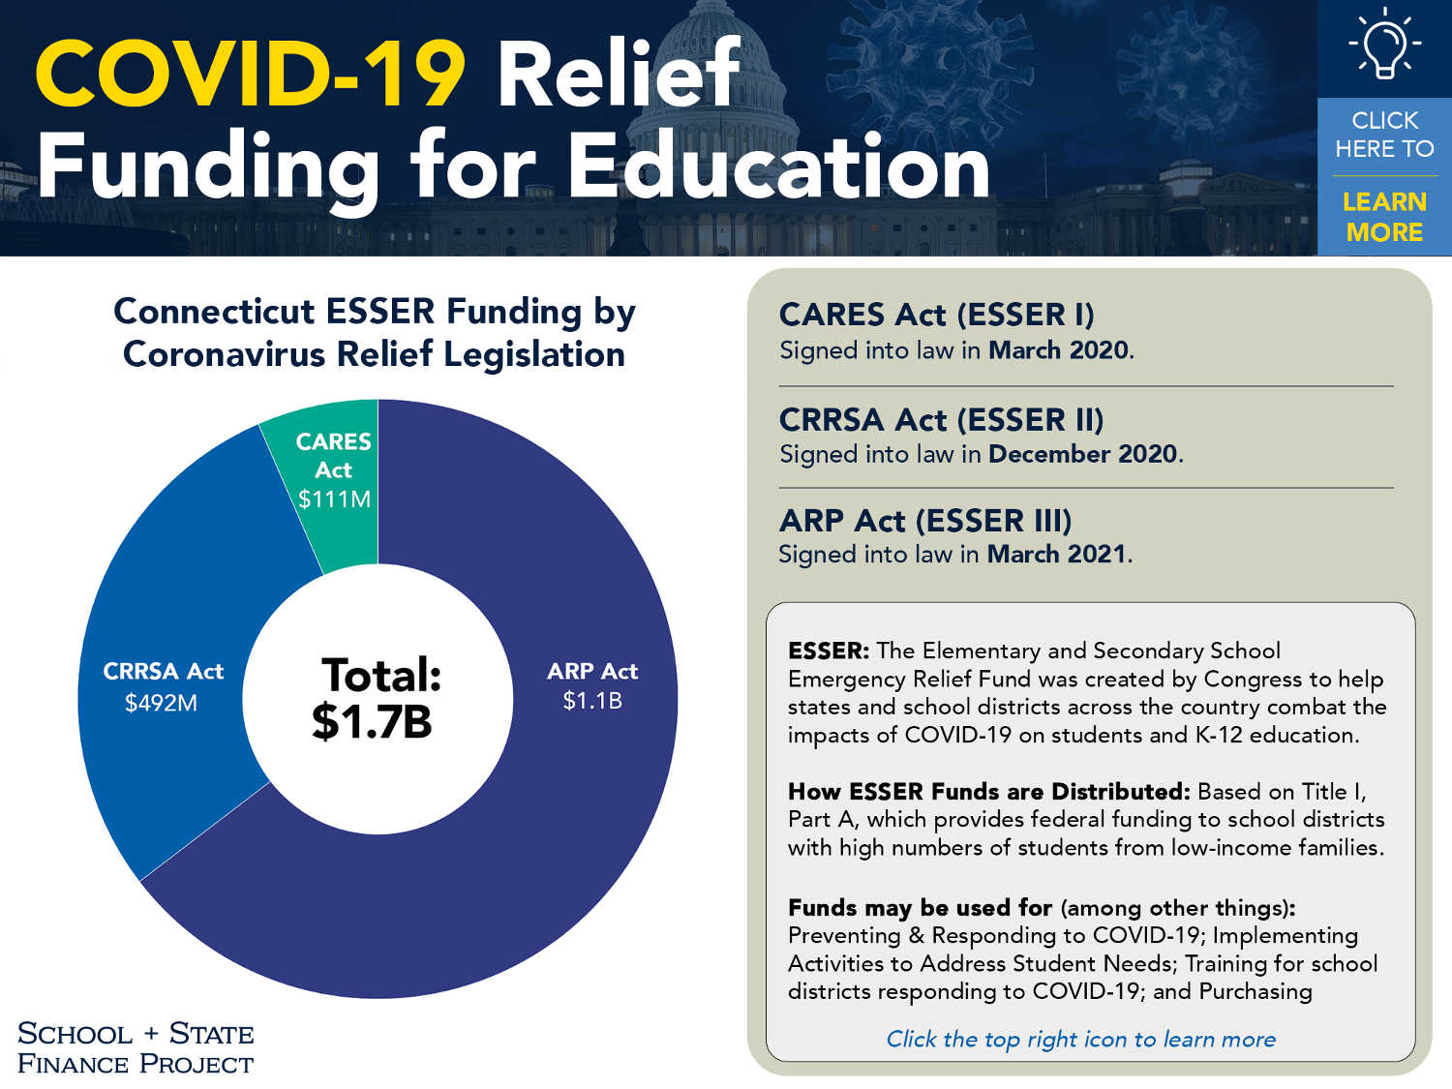

Slide 61
What You Can Do

Slide 62
Participate at the Local Level
Attend Board of Education Meetings meetings
Board of Education Meeting Listing
Submit public testimony at the Board of Education and City Council during budget season
Reach out to local decision-makers to ask questions, begin a conversation about education funding, or ask them to support state initiatives that will benefit Hartford Public Schools
The members of the Board of Education can be found here, along with their contact information.
City Council members can be found here, along with their contact information.

Slide 63
Participate at the State Level
Reach out to your State Representative
Rep. Julio Concepcion
Rep. Minnie Gonzalez
Rep. Joshua Hall
Rep. Maryam Khan
Rep. Matt Ritter
Rep. Edwin Vargas
If you aren’t sure who your Representative is, you can find out here.
Reach out to your State Senator
Sen. John Fonfara
Sen. Doug McCrory
Not sure what to say? Reach out to us for helpful tips here!

Slide 64





Add Your Voice to the Conversation
Talk abut school finance with others
Attend local municipal meetings such as the board of education, city/town council, or subcommittee meetings
Host a workshop or meeting with us
Stay informed and help keep others informed
Let elected officials know school finance is an important issue for kids in your community

Slide 65
Appendix

Slide 66
How Do Other Public School Students Receive Funding?

Slide 67


CT Has More than 10 different funding formulas

Slide 68

State Charter Schools
(21 schools)

Slide 69

Local Charter Schools
(1 school)

Slide 70

CT Technical Education and Career System
(20 schools)

Slide 71
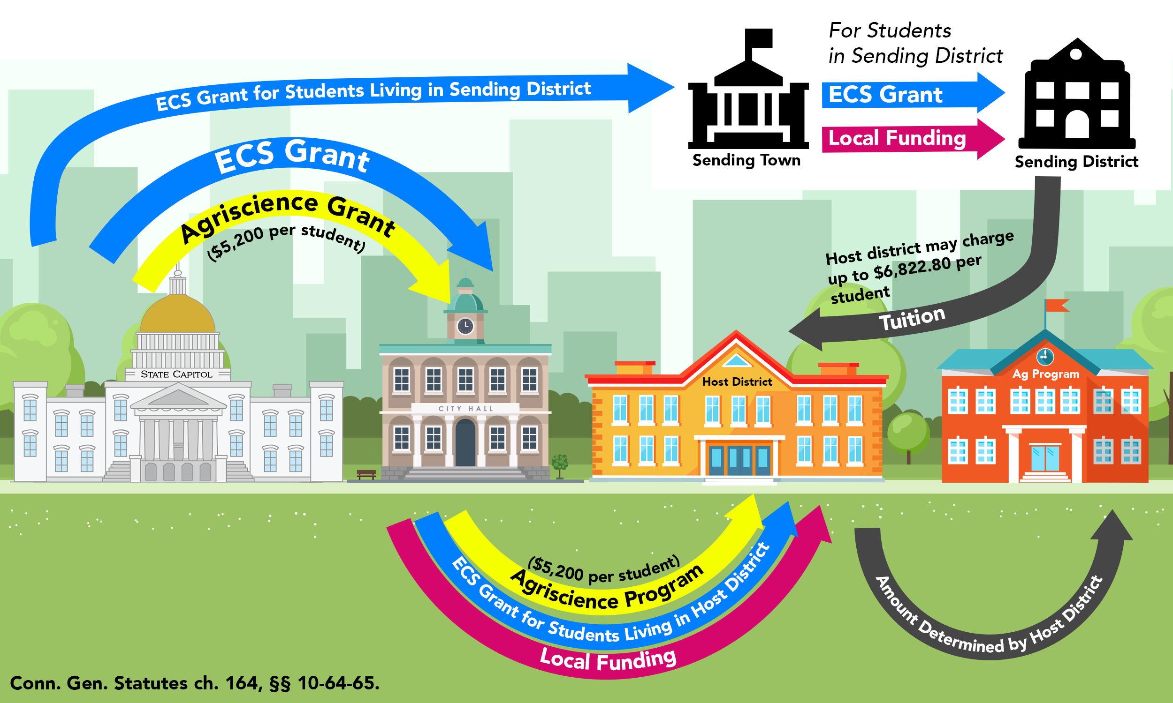
Agriscience Program
(20 centers)

Slide 72
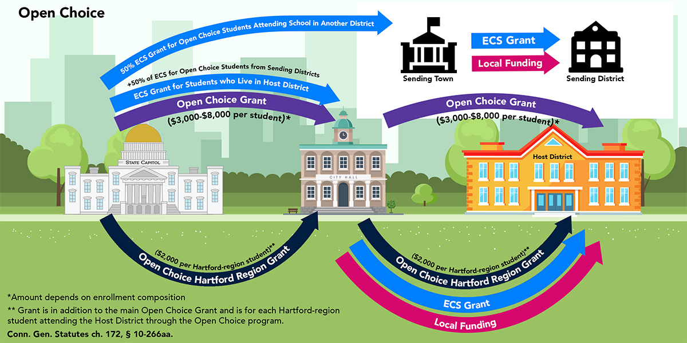
Open Choice
(47 participating districts)

Slide 73
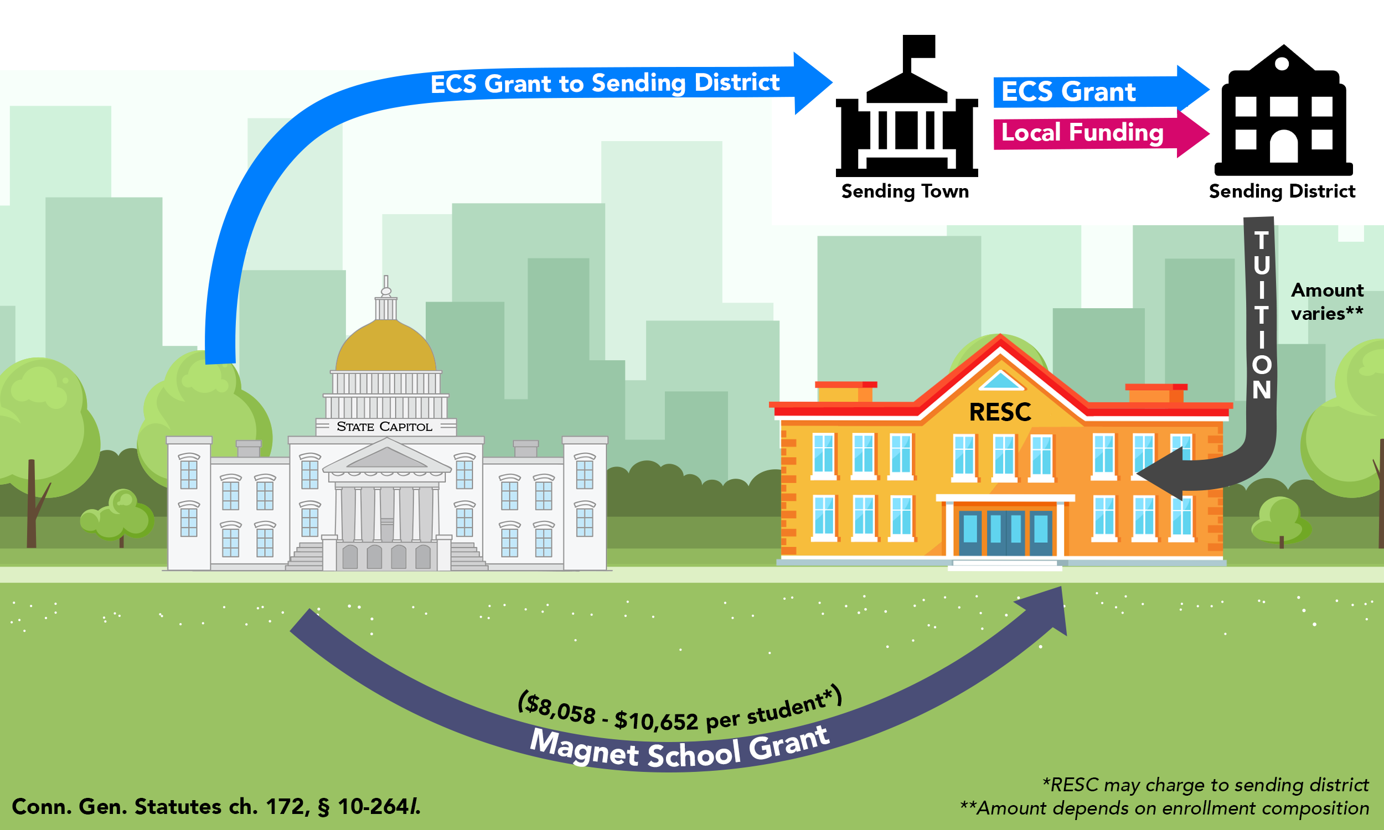
Regional Educational Service Center (RESC) Magnet School (Sheff)
(18 schools)

Slide 74
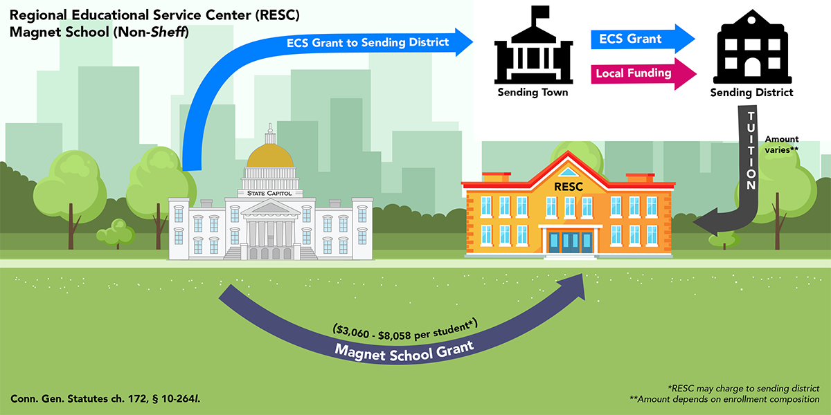
Regional Educational Service Center (RESC) Magnet School (Non-Sheff)
(12 schools)

Slide 75
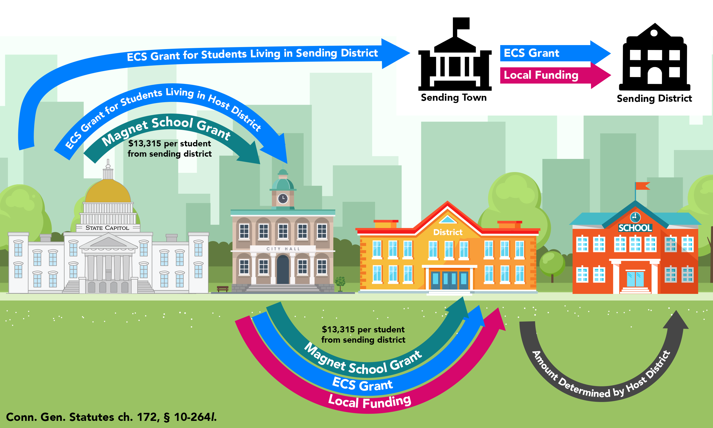
Host District Magnet (Sheff)
(20 schools)

Slide 76
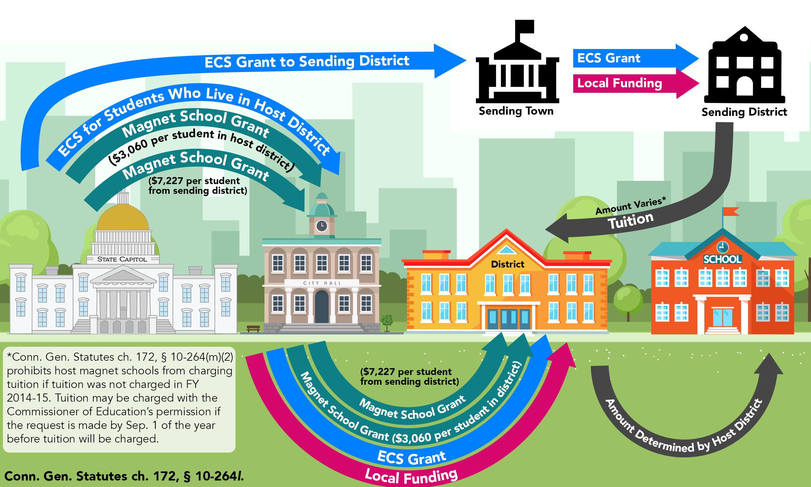
Host District Magnet (Non-Sheff)
(34 schools)

